Slide 1
Overview of Docker Swarm:
Docker Swarm is an orchestration tool for managing and scaling Docker containers.
It extends Docker's capabilities to deploy and manage containerized applications across multiple nodes.
2. Key Concepts:
Nodes:
Managers: Nodes responsible for orchestration tasks, including accepting commands and managing the state of the swarm.
Workers: Nodes that execute containerized tasks as directed by the managers.
Services:
Services in Docker Swarm define how a containerized application should behave in production. This includes details such as the number of replicas and how they scale.
Tasks:
Tasks represent the basic unit of work in Docker Swarm. Each task corresponds to a running container on a node.
Swarm:
A Swarm is a group of Docker nodes that are connected to each other, forming a unified cluster for managing containers.

Slide 2
3. Advantages of Docker Swarm:
Scalability:
Docker Swarm allows for easy scaling of applications by adding or removing containers, helping meet changing demand effortlessly.
Load Balancing:
The built-in load balancing distributes incoming requests among the containers, ensuring optimal utilization of resources
High Availability:
Tasks are distributed across multiple nodes, ensuring that even if one node fails, the application remains available on other nodes.
Rolling Updates:
Docker Swarm supports rolling updates, enabling the updating of services without causing downtime, ensuring a seamless user experience.

Slide 3
How to Set Up a Docker Swarm:
Installing Docker:
Docker needs to be installed on each node in the Swarm.
Initializing a Swarm:
Use the docker swarm init command on a Manager node to initialize the Swarm.
Joining Nodes:
Worker nodes can join the Swarm by running the docker swarm join command with the token provided during initialization.
Verification:
Confirm the status of the Swarm with the docker node ls command.

Slide 4
Swarm Services and Stacks:
Services:
Define and deploy services using Docker Compose or directly through the Docker CLI. Services encapsulate the details of running containers.
Stacks:
Stacks provide a way to manage multiple services, networks, and volumes in a single file. Deploy stacks using the docker stack deploy command.
Scaling and Load Balancing:
Scaling Services:
Adjust the number of replicas for a service to scale horizontally.
Load Balancing:
Swarm provides built-in load balancing to distribute incoming traffic among the replicas of a service, ensuring efficient resource utilization.

Slide 5
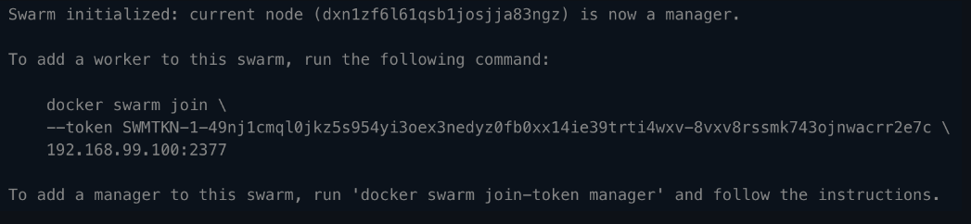
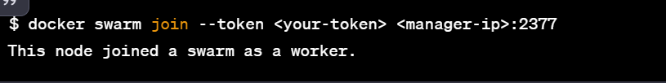
Initialize Swarm on Manager Node:
Join Worker Node to the Swarm:

Slide 6
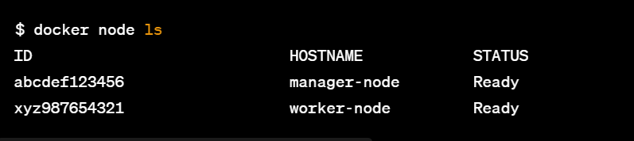
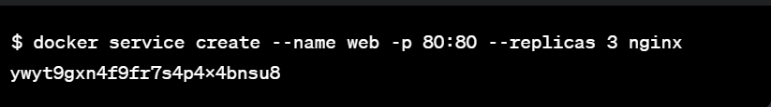
Verify Swarm Status
Deploying a Service:
Create a Sample Service:

Slide 7
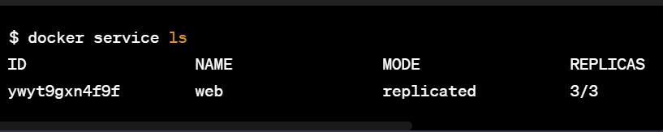
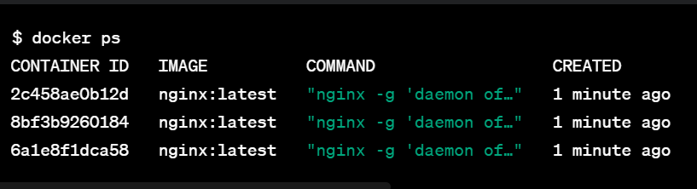
Check Service Status:
View Containers:

Slide 8
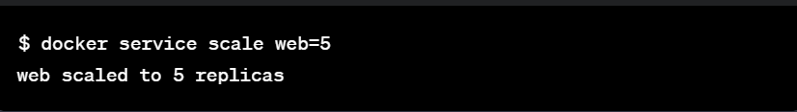
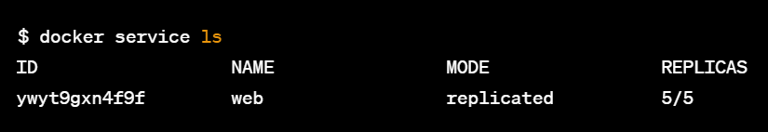
Scaling and Load Balancing:
Scale the Service:
Verify Scaling:

Slide 9

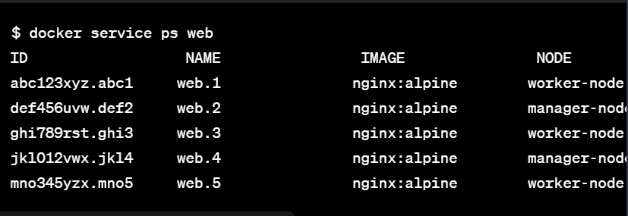
Rolling Updates:
Update Service Image:
Verify Rolling Update:

Slide 10
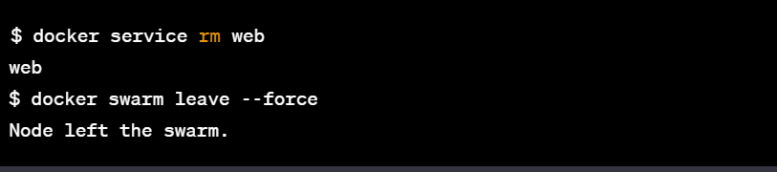
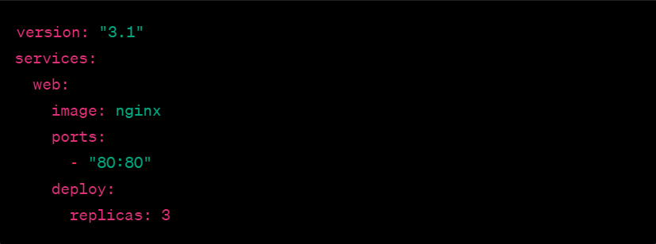
Cleanup:
Remove Service and Leave Swarm:
Docker Compose allows you to define and deploy multi-container applications using a single Compose file.
The docker stack deploy command is used in a Docker Swarm environment to deploy an entire stack.
Stacks simplify the deployment and management of multi-service applications.

Slide 11

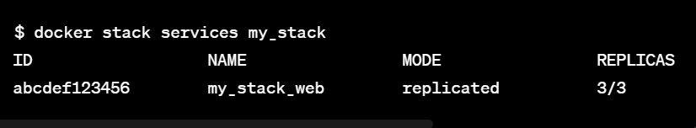
Deploy the Stack using docker stack deploy command:
View Stack Services:

Slide 12
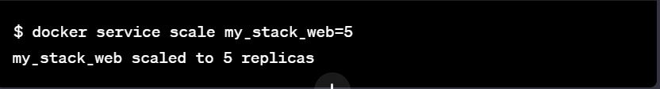
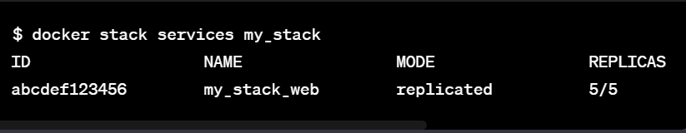
Scale the Stack:
Verify Scaling:

Slide 13
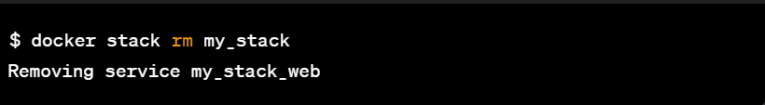
Remove Stack and Leave Swarm:

Slide 14
docker swarm commands
docker swarm init | Initialize a swarm
docker swarm join --toke­n<m­ana­ger­-to­ken> 10.1.0.2:2377 | Join an existing swarm as manager node
docker swarm join --toke­n<w­ork­er-­tok­en> 10.1.0.2:2377 | Join a swarm as a worker node
docker swarm leave | Leave the swarm
docker service commands

Slide 15
docker node ls | List nodes in the swarm
docker node ps | List tasks running on one or more nodes, defaults to current node
docker node rm [OPTIONS] NODE [NODE...] | Remove one or more nodes from the swarm
docker node demote NODE [NODE...] | Demote one or more nodes from manager in the swarm
docker node promote NODE [NODE...] | Promote one or more nodes to manager in the swarm

Slide 16
docker service commands
docker service create --replicas 5 -p 80:80 --name web nginx | create docker service directly (similar to docker run command)
docker service logs [OPTIONS] SERVIC­E|TASK | Fetch the logs of a service or task, in option you can use -f,--d­etails etc
docker service ls | list all the services
docker service ps [OPTIONS] SERVICE [SERVI­CE...] | List the tasks of one or more services
docker service rm SERVICE [SERVI­CE...] | Remove one or more services
docker service scale SERVIC­E=R­EPLICAS [SERVI­CE=­REP­LIC­AS...] | Scale one or multiple replicated services
docker service update [OPTIONS] SERVICE | Update a service

Slide 17
docker stack deploy nodeapp -c docker­­-c­o­m­po­­se.yml | deploy the stack using docker­­-c­o­mpose file , Swarm does not support the build option if defined in the Compose file(but docker compose up uses it).
docker stack ls | shows all stacks along with list of services in the stack
docker stack services <st­ack­-na­me> | list the services in the stack.
docker stack ps <st­ack­-na­me> | list all the tasks in the stack.
docker stack rm <st­ack­-na­me> | removes the stack.

